Slide 1


WELCOME BACK,
Mustangs!
Murray Manor Elementary
8305 El Paso St. La Mesa, CA 91942
619-668-5865
https://www.lmsvschools.org/murraymanor/

Slide 2
SAFETY
FIRST
Frequent and regular handwashing
Campus access for staff and students only after school begins.
Parents may walk students to classroom in the morning but need to be off campus by 8:05am.

Slide 3
OUR
SCHEDULE
Monday - Friday
7:45am - Gates Open
7:55am - First Bell
8:00am - Gates Close/School Starts
20 minute Recess/Snack (between 10:10 - 10:55)
40 minute Lunch/Recess (between 11:30 - 1:00)
2:20pm - Dismissal (M, W, TH, F)
1:05pm - Dismissal EVERY TUESDAY

Slide 4
ARRIVAL
Student arrival begins at 7:45am (unless student is enrolled in ESS)
Kinder and TK students will enter through the Kinder Gate
Primary students will enter through the main entrance/gate
Upper grade students (4-6) will enter through the east gate (staff parking lot)
The school frontage road is for drop off only (no parking)
Parking is available on El Paso and neighboring streets
No student drop off in the staff parking lot
Parents can walk students to class in the morning but need to be off campus by 8:05am. If you are volunteering, please check in to the office and get a badge.
Breakfast is free for all students. Students not getting breakfast can walk straight to class
Staff members will be available daily to help all students find their classrooms

Slide 5
SCHOOL
DISMISSAL
Dismissal is at 2:20pm (1:05pm on Tuesdays)
Parents/Guardians may not go past the gates onto campus until 2:20pm (or 1:05pm on Tuesdays)
Kinder and TK parents will enter through the kinder gate to pick up your child(ren) from the teacher on the kinder playground
Primary parents will enter through the main gate to pick up your child(ren) at the classroom
Upper grade parents may enter through the east gate
Once your student(s) are with you, please exit campus
Drive through pick up will also be available
  Let your child’s teacher know if you plan to use the drive through to pick up your child
  Please have a sign visible with your child’s name and grade level on it to help with drive-through pick up

Slide 6
TIPS FOR ARRIVAL & DISMISSAL
Have patience with staff and other drivers
Be safe and follow directions from staff and School Safety Patrol
DO NOT PARK and leave your car unattended in the drive through lane
Use designated crosswalks
Be mindful and respectful of our neighbors and neighboring businesses
Be Kind

Slide 7
SNACKS & LUNCH
Students can enjoy a snack during recess time. Snacks should be snack-size and quick and easy to open/eat
Free lunch is available for all students. We receive funding for every student who receives a meal at school - regardless of need.
Lunch from home - easy/independent packages, one time use packaging (suggested)
Avoid - Gogurts, juice pouches, fruit cups, messy finger foods, family-size bags of chips/cookies

Slide 8
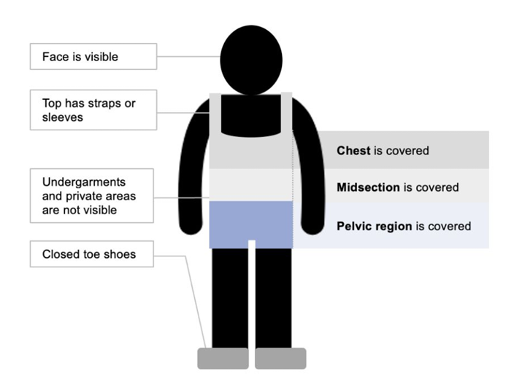
DRESS FOR SUCCESS
It’s warm! Clothing must have straps and cover the entire area shown in the diagram. Closed toe shoes are required (no sandals or flip flops).

Slide 9
TIPS FOR SUCCESS
Make a plan and review it with your child
Do a practice run on arrival procedures
Practice an independent lunch - pack all lunch items in bag at home and have your child practice opening without assistance
Label everything that will come with your child to school: water bottles, jackets, lunch boxes, backpacks, etc.

