Slide 1


WELCOME BACK,
Mustangs!
Murray Manor Elementary
8305 El Paso St. La Mesa, CA 91942
619-668-5865
https://www.lmsvschools.org/murraymanor/

Slide 2
SAFETY
FIRST
Campus access for staff and students only after school begins.
Parents may walk students to classroom in the morning but need to be off campus by 8:05 am so we may secure the campus.
During the school day, students may be released only to guardians (or a prearranged emergency contact). We also require that guardians or emergency contacts show id.
Staff and students participate in monthly safety drills.

Slide 3
OUR
SCHEDULE
Monday - Friday
7:45am - Gates Open
7:55am - First Bell
8:00am - Gates Close/School Starts
20 minute Recess/Snack (between 10:10 - 10:55)
40 minute Lunch/Recess (between 11:30 - 1:00)
2:20pm - Dismissal (M, W, TH, F)
1:05pm - Dismissal EVERY TUESDAY

Slide 4
ARRIVAL
Student arrival begins at 7:45am (unless student is enrolled in ESS). After 8:00 am, students receive a tardy pass.
Kinder and TK students typically enter through the Kinder Gate, primary students enter through the main entrance/gate and upper grade students (4-5) enter through the 4th/5th gate (staff parking lot)
The school frontage road is for drop off only (no parking)
Parking is available on El Paso and neighboring streets
No student drop off in the staff parking lot
Parents can walk students to class in the morning but need to be off campus by 8:05am. If you are volunteering, please check in to the office and get a badge. Volunteers must check-in with an ID through Ident-A-Kid.
Breakfast is free for all students and served before 8:00 am or during recess break. Students not getting breakfast can walk straight to class
Staff members will be available daily to help all students find their classrooms

Slide 5
SCHOOL
DISMISSAL
Dismissal is at 2:20pm (1:05 pm on Tuesdays)
Parents/Guardians may not enter campus until 2:20 pm (or 1:05 pm on Tuesdays).
We ask that you refrain from picking up your child within the last twenty minutes of the school day.
Kinder and TK parents will pick up your child(ren) from the teacher at the classroom.
All other grade levels, please make a plan, with your child, for a pick-up location, whether on campus or in the drive through pick up lane.
Once your student(s) are with you, please exit campus at the end of the day.
When using the drive through pick up, make sure that you are pulled over to the right side curb. For their safety, students may not cross through the drive through to get to their car

Slide 6
TIPS FOR ARRIVAL & DISMISSAL
Have patience with staff and other drivers
Be safe and follow directions from staff and School Safety Patrol
DO NOT PARK and leave your car unattended in the drive through lane
We encourage families to park in the neighborhood and walk onto campus.
Use designated crosswalks
Be mindful and respectful of our neighbors and neighboring businesses
Be Kind

Slide 7
SNACKS & LUNCH
Snacks sent from home should be snack-size and quick and easy to open and eat.
Free lunch is available for all students.
Lunch from home - easy/independent packages, one time use packaging (suggested)
Please try to avoid - Gogurts, juice pouches, fruit cups, messy finger foods, family-size bags of chips/cookies
We encourage families to send healthy snacks. Candy, soda and gum are not allowed.

Slide 8
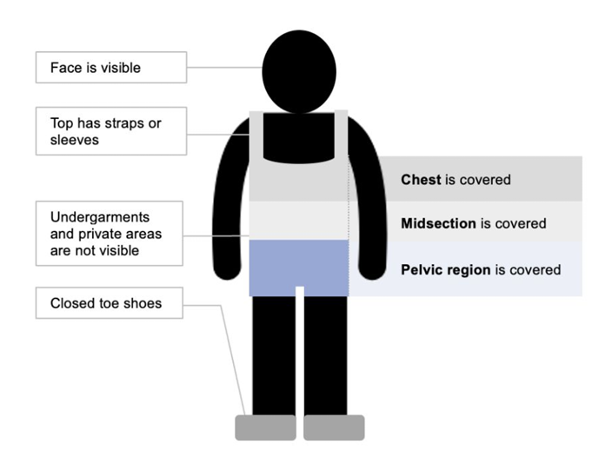
DRESS FOR SUCCESS
It’s warm! Clothing must have straps and cover the entire area shown in the diagram. Closed toe shoes are required (no sandals or flip flops).

Slide 9
TIPS FOR SUCCESS
Be at school, on time, every day!
Consistent routines are helpful for elementary students.
Make a plan for school arrival and pick-up and review it with your child
Practice an independent lunch - pack all lunch items in bag at home and have your child practice opening without assistance
Label everything that will come with your child to school: water bottles, jackets, lunch boxes, backpacks, etc.

Slide 10
SCHOOL BEHAVIOR
Murray Manor uses positive behavior practices to model and promote positive behaviors and trusting relationships. Teachers work hand in hand with support staff to care for student needs.
We are a Peacebuilder School
  We praise people
  Give up put downs
  Seek wise people
  Notice and speak up about hurts we have caused
  Right wrongs
  Help Others

Slide 11

SMART PHONES & WATCHES
All phones must be kept in student’s backpack for the entire school day. Phones may only be used for communication purposes after school and outside of the school gates.
Smart Watches may be used only for timekeeping. Students are not permitted to play games, access the internet, or take a video or recording while at school.
Students who do not follow this policy will receive
1st offense: Warning
2nd offense: Note sent home by teacher
3rd offense: Principal phone call
4th offense: Phone or Smart Watch kept in office until dismissal

Slide 12
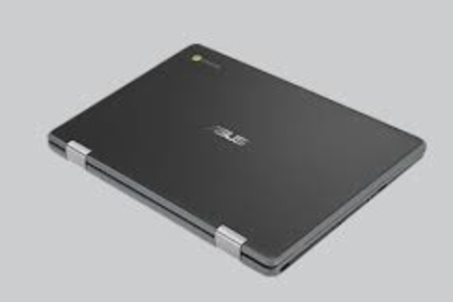
DIGITAL CITIZENSHIP
Student must follow signed district technology policies.
All technology is school property and must only be used for school assignments.
Teachers are able to monitor student technology activity through Go Guardian.
Students who misuse technology will have a conference with the principal and a phone call to parents.
Continued misuse of technology may result in loss of chromebook.

Slide 13
Supervision
La Mesa Spring Valley employs campus attendants at our elementary school sites to help with supervision of students before and after school, and at lunch and recess. Campus attendants work to promote a safe and welcoming environment for our students. They are some of the many caring adults at Murray Manor that can help students with any questions or concerns during the day.

Slide 14
Community
We are so glad that you and your child are part of our Murray Manor community. There are many ways to get involved:
Peace Corral Fridays at 8:00 am
Volunteer in the classroom
Stay up to date with weekly Parent Updates (Friday afternoon)
PTA and school events
Back to School Night
Teacher communication

