Slide 1

Measure V
Bond Program Update
1
La Mesa – Spring Valley Schools
Presentation to the Citizens’ Bond Oversight Committee
May 17, 2023
Mark Claussen, Bond Program Manager

Slide 2
Program Update Overview
2
Current Project Status
Upcoming Activities
Financial Summary
Schedule Summary
Measure V CBOC Update May 17, 2023

Slide 3
Current Project Status
3
  Since Last Report March 15, 2022
  Continue Bundle A Entrance Improvements four Middle Schools
  Received Bids for Bundle B work
  Continue Design of Bundle C, D, and E School Site Improvements
  Release RFQ for Lease Lease-Back (LLB) development teams Bundles D and E
  Start drainage analysis STEAM fields
Measure V CBOC Update May 17, 2023

Slide 4
Bundle B Bid Result Summary
4
Summer 2023 construction start
Amendment to LLB contract approved at May 9 Governing Board
  Spring Valley Academy $2,466,601
  Casa de Oro $3,119,559
  Highlands Elementary $1,291,371
  Loma Elementary $ 934,806
  Murdock Elementary $1,916,296
  Sweetwater Springs Elementary $1,443,077
  Construction Bid Results $11,297,196
  Construction Budget $11,796,687 $499,491 under budget
Measure V CBOC Update May 17, 2023

Slide 5
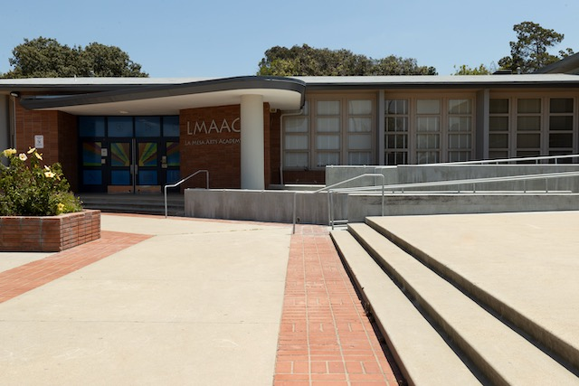
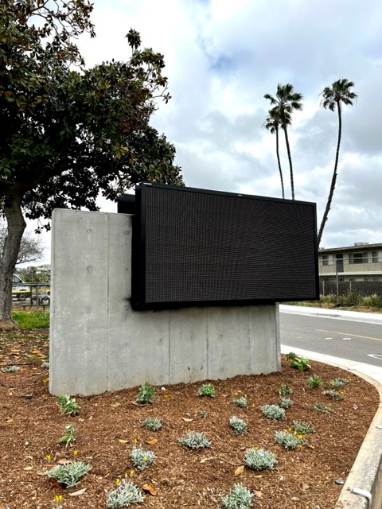
LMACC Entrance Modernization
5
Access Improvements, New Marquee, Landscaping
Measure V CBOC Update May 17, 2023

Slide 6
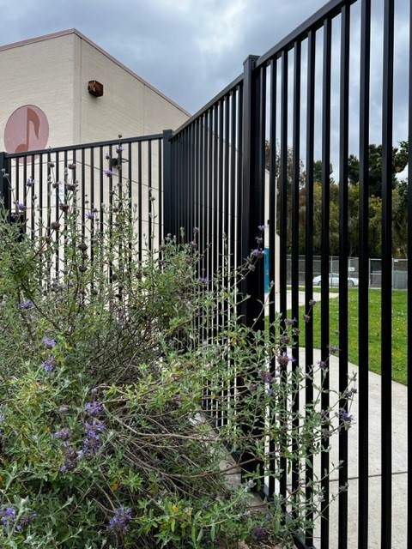

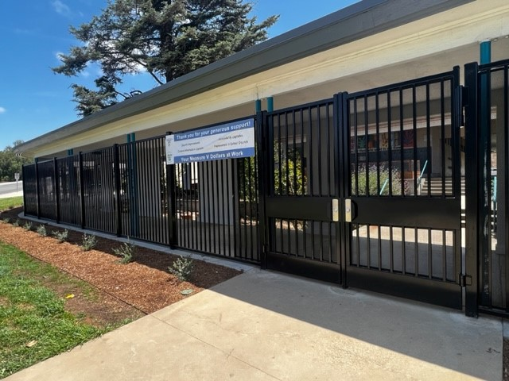
LMACC Entrance Modernization
6
Fencing, Graphic Panels, Paint
Measure V CBOC Update May 17, 2023

Slide 7
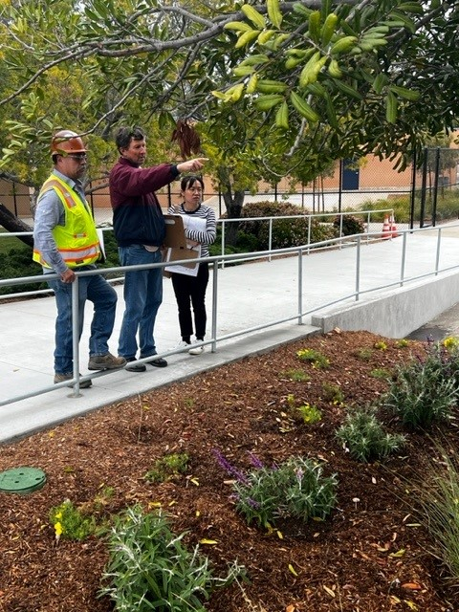
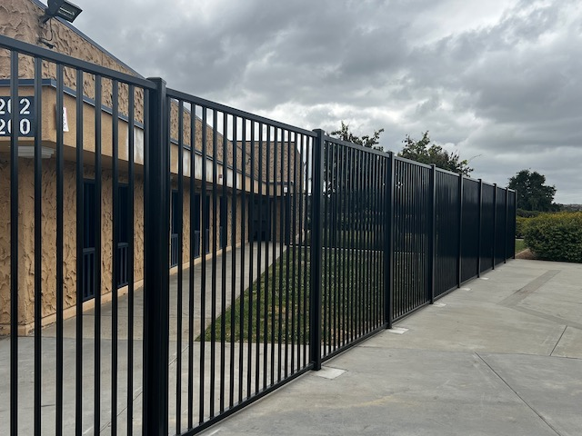

STEAM Academy
7
Access Improvements, New Marquee, Fencing, Landscaping, Graphic Panels
Measure V CBOC Update May 17, 2023

Slide 8
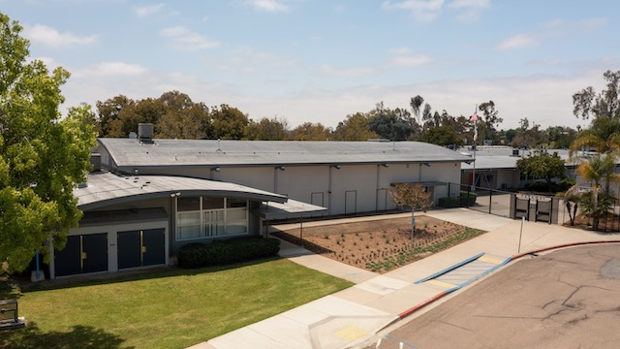

Parkway Sports and Health Science Academy
8
New Marquee, Landscaping, Graphic Panels, Painting
Measure V CBOC Update May 17, 2023

Slide 9
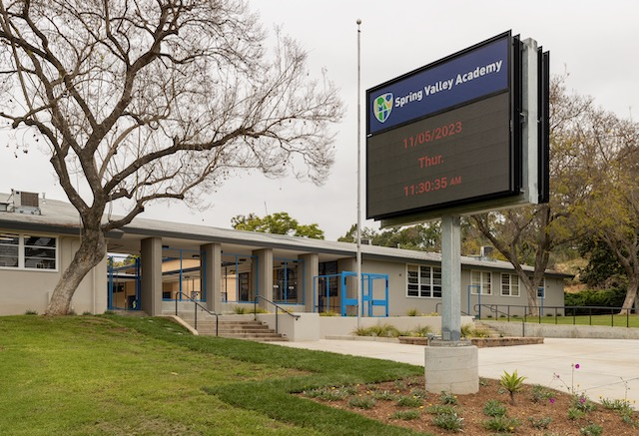
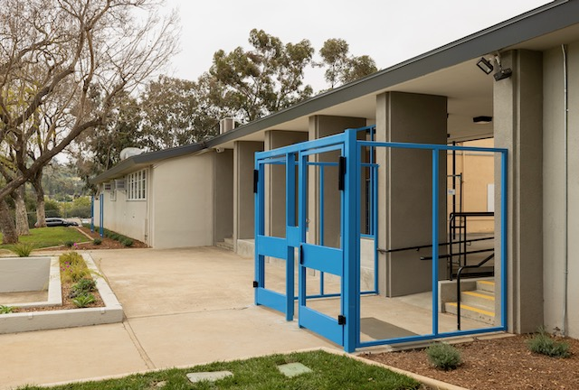
Spring Valley Academy
9
New Marquee, Landscaping, Window Graphics, Paint
Measure V CBOC Update May 17, 2023

Slide 10
Upcoming Activities
10
  Start Bundle B construction, 7 School Site Improvements
  Continue Design of Bundle C, D, and E School Site Improvements
  Select LLB contractor Bundles D & E
Measure V CBOC Update May 17, 2023

Slide 11
Program Finanacials
Current Program Financial Summary
11
Project Name | Original Budget | Current Budget | Budget Changes | Committed Costs | Expenditures | Remaining Budget | % Committed
Elementary Schools
Avondale Site Improvements | $2,640,853.53 | $2,147,528.43 | ($493,325.10) | $229,504.90 | $66,785.90 | $1,918,023.53 | 10.69%
Bancroft Site Improvements | $1,893,596.29 | $1,850,271.19 | ($43,325.10) | $189,804.90 | $58,351.50 | $1,660,466.29 | 10.26%
Casa de Oro Site Improvements | $4,121,685.39 | $3,754,236.87 | ($367,448.52) | $441,916.28 | $309,737.64 | $3,312,320.59 | 11.77%
Fletcher Hills Elementary School | $4,142,269.06 | $4,145,479.86 | $3,210.80 | $264,745.80 | $22,174.65 | $3,880,734.06 | 6.39%
Highlands Elementary Site Improvements | $1,602,953.80 | $2,071,531.58 | $468,577.78 | $277,715.59 | $225,353.95 | $1,793,815.99 | 13.41%
Kempton Site Improvements | $2,676,367.30 | $2,284,825.98 | ($391,541.32) | $249,218.68 | $73,670.18 | $2,035,607.30 | 10.91%
La Mesa Dale Site Improvements | $8,497,137.87 | $9,883,280.07 | $1,386,142.20 | $718,118.09 | $207,061.76 | $9,165,161.98 | 7.27%
La Presa Site Improvements | $4,987,447.34 | $4,880,365.46 | ($107,081.88) | $378,313.12 | $103,281.12 | $4,502,052.34 | 7.75%
Lemon Avenue Site Improvements | $1,751,735.70 | $1,646,141.21 | ($105,594.49) | $197,265.85 | $64,755.52 | $1,448,875.36 | 11.98%
Loma Elementary Site Improvements | $782,071.17 | $951,804.75 | $169,733.58 | $149,491.22 | $120,482.58 | $802,313.53 | 15.71%
Maryland Avenue Site Improvements | $1,584,913.59 | $1,469,319.10 | ($115,594.49) | $183,601.72 | $64,500.42 | $1,285,717.38 | 12.50%
Murdock Site Improvements | $1,659,839.77 | $2,853,103.81 | $1,193,264.04 | $228,052.58 | $148,549.56 | $2,625,051.23 | 7.99%
Murray Manor Site Improvements | $2,273,753.02 | $2,273,753.02 | $0.00 | $167,845.00 | $20,680.54 | $2,105,908.02 | 7.38%
Northmont Site Improvements | $5,408,296.52 | $5,411,170.54 | $2,874.02 | $345,147.00 | $37,193.64 | $5,066,023.54 | 6.38%
Rancho Site Improvements | $2,001,411.81 | $2,108,443.46 | $107,031.65 | $188,991.65 | $62,141.15 | $1,919,451.81 | 8.96%
Rolando Site Improvements | $2,755,932.66 | $3,630,338.17 | $874,405.51 | $255,090.34 | $66,287.63 | $3,375,247.83 | 7.03%
Sweetwater Springs Site Improvements | $5,629,939.77 | $3,958,261.57 | ($1,671,678.20) | $534,262.16 | $389,667.28 | $3,423,999.41 | 13.50%
Middle Schools
Parkway Middle School Entrance Modernizations | $628,359.69 | $623,275.50 | ($5,084.19) | $623,275.50 | $400,506.44 | $0.00 | 100.00%
Parkway Middle School Improvements | $16,669,083.19 | $16,707,398.74 | $38,315.55 | $1,050,637.24 | $97,712.99 | $15,656,761.50 | 6.29%
La Mesa Arts Academy Entrance Modernizations | $628,359.70 | $1,011,163.50 | $382,803.80 | $974,135.31 | $693,786.65 | $37,028.19 | 96.34%
La Mesa Arts Academy Site Improvements | $5,568,238.99 | $4,860,487.38 | ($707,751.61) | $646,503.11 | $303,185.89 | $4,213,984.27 | 13.30%
Spring Valley Academy Entrance Modernizations | $628,359.69 | $768,275.50 | $139,915.81 | $747,693.14 | $389,051.87 | $20,582.36 | 97.32%
Spring Valley Academy Site Improvements | $3,389,591.21 | $3,449,384.21 | $59,793.00 | $383,588.30 | $285,681.12 | $3,065,795.91 | 11.12%
STEAM Academy Entrance Modernizations | $628,359.69 | $782,874.50 | $154,514.81 | $771,131.66 | $560,461.40 | $11,742.84 | 98.50%
STEAM Academy Site Improvements | $4,621,369.51 | $4,781,863.53 | $160,494.02 | $383,588.30 | $114,083.02 | $4,398,275.23 | 8.02%
Other District Sites
STEAM Slope Stabilization | $6,606,524.75 | $6,560,840.70 | ($45,684.05) | $2,282,329.95 | $2,076,388.20 | $4,278,510.75 | 34.79%
Infrastructure Repairs - Districtwide | $6,443,178.98 | $6,443,178.98 | $0.00 | $0.00 | $0.00 | $6,443,178.98 | 0.00%
Energy Efficiency Projects - Districtwide | $10,371,056.42 | $10,371,056.42 | $0.00 | $10,371,056.42 | $10,371,056.42 | $0.00 | 100.00%
Security Fencing | $718,290.00 | $718,289.50 |  | $718,289.50 | $681,390.50
Operations Center Trailer Demolition | $65,252.63 | $150,732.64 | ($3,146.63) | $150,732.64 | $150,732.64 | $0.00 | 100.00%
Portable Building | $329,545.99 | $92,655.75 | ($291,369.27) | $92,655.75 | $92,655.75 | $0.00 | 100.00%
Operations Center Site Improvements | $1,908,207.11 | $1,931,510.38 | $23,303.27 | $201,727.37 | $41,490.77 | $1,729,783.01 | 10.44%
Education Service Center |  |  |  |  |  | $0.00
Education Center Site Improvements | $6,248,616.17 | $6,248,616.17 | $0.00 | $0.00 | $0.00 | $6,248,616.17 | 0.00%
Program Common Costs & Contingencies
Program Administration | $9,855,691.69 | $8,660,922.64 | $0.00 | $2,543,066.73 | $1,785,756.25 | $6,117,855.91 | 29.36%
Program Contingency | $3,000,000.00 | $2,941,736.02 | $451,281.00 | $0.00 | $0.00 | $2,941,736.02 | 0.00%
Program Reserve | $4,000,000.00 | $4,000,000.00 | $0.00 | $0.00 | $0.00 | $4,000,000.00 | 0.00%
Program Totals | $136,000,000.00 | $136,424,117.13 | $1,267,035.99 | $26,939,495.80 | $20,084,614.93 | $109,484,621.33 | 19.75%
Measure V CBOC Update May 17, 2023
Notes:
actionButton
No alt text provided
actionButton
No alt text provided
actionButton
No alt text provided
lineStackedColumnComboChart
No alt text provided
Cashflow
No alt text provided
Cashflow
No alt text provided
actionButton
No alt text provided
image
No alt text provided
basicShape
No alt text provided
La Mesa - Spring Valley School Facilities Master Plan Dashboard
No alt text provided
image
No alt text provided
basicShape
No alt text provided
basicShape
No alt text provided
basicShape
No alt text provided
basicShape
No alt text provided
basicShape
No alt text provided
basicShape
No alt text provided
actionButton
No alt text provided
actionButton
No alt text provided
Spending Gauge
No alt text provided
Remaining Budget
No alt text provided
Job to Date Costs
No alt text provided
Current Budget
No alt text provided
tableEx
No alt text provided

Slide 12
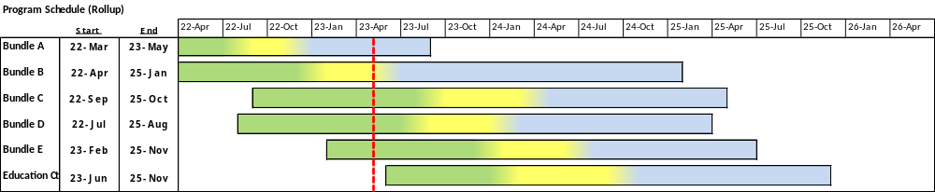
Schedule
12
 |  |  | Design |  |  |  | DSA & Bidding Award |  |  |  | Construction & Closeout |  |  |  | Current Date
Measure V CBOC Update May 17, 2023

Slide 13
Measure V Bond Program Update
13
Questions…..
Measure V CBOC Update March 15, 2023

