Slide 1

Measure V
Bond Program Update
1
La Mesa-Spring Valley Schools
Presentation to the Citizens’ Bond Oversight Committee
March 19, 2025
Dr. Robert Cochran, Executive Director, Business Services
Daniel Young, Executive Director, Facilities Planning and Construction
Mark Claussen, Measure V Bond Program Manager

Slide 2
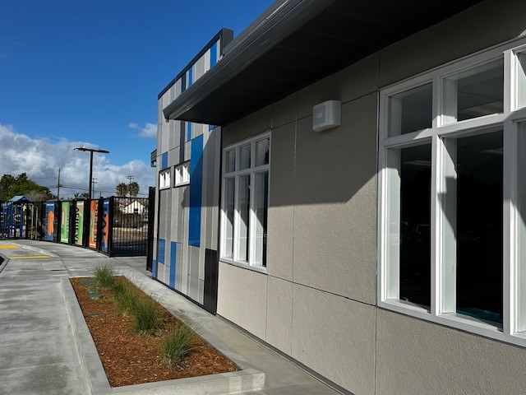
Program Update Overview
2
Current Project Status
Upcoming Activities
Financial Summary
Schedule Summary
Local Labor Participation
Measure V CBOC Update March 19,2025

Slide 3
Bundle A Construction
3
Bundle A Complete
  Parkway Entry Improvements
  Spring Valley Academy Entry Improvements
  STEAM Academy Entry Improvements
  La Mesa Arts Academy Entry Improvements
  Steam Slope Stabilization Complete
  STEAM Plaster Work Complete
Measure V CBOC Update March 19, 2025

Slide 4
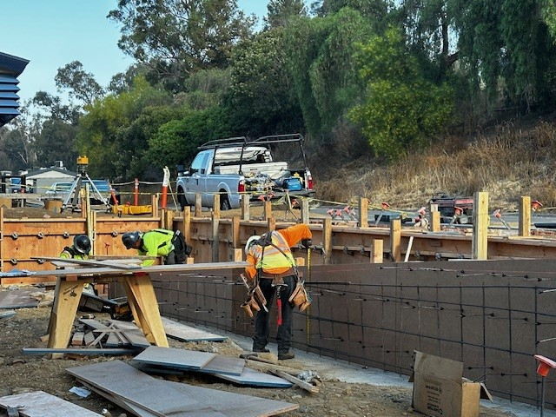
Bundle B Construction
4
Bundle B Complete
  Casa de Oro Complete
  Spring Valley Academy Complete
  Highlands Elementary Complete
  Sweetwater Springs Elementary Complete
  Murdock Elementary Complete
  Operations Center Improvements Complete
  Loma Elementary Complete
ADA Access
Measure V CBOC Update March 19, 2025

Slide 5
Bundle C Construction
5
  Rolando Construction 96% Complete
  LMAAC Construction 98% Complete
  La Mesa Dale Construction 94% Complete
  Lemon Avenue Construction 60% Complete
  Maryland Avenue Construction 80% Complete
Measure V CBOC Update March 19, 2025

Slide 6
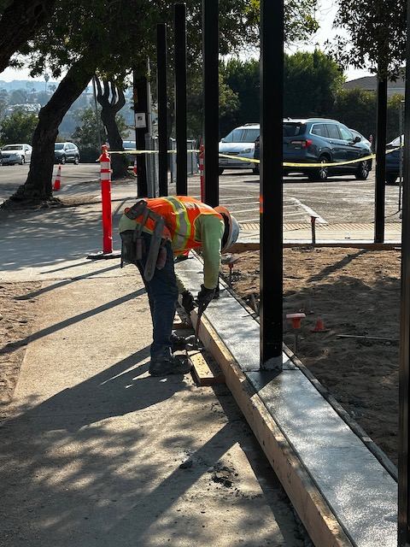
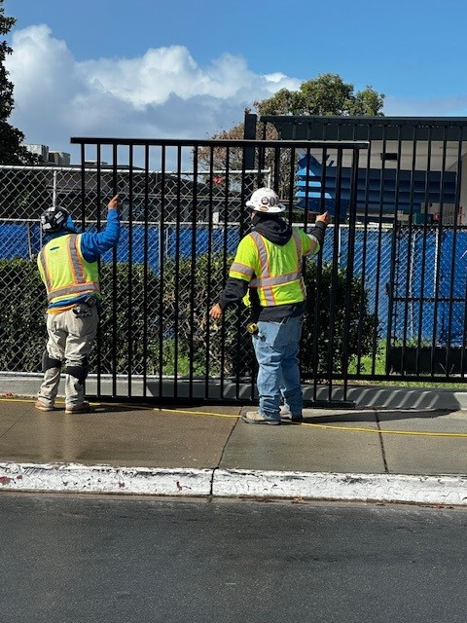
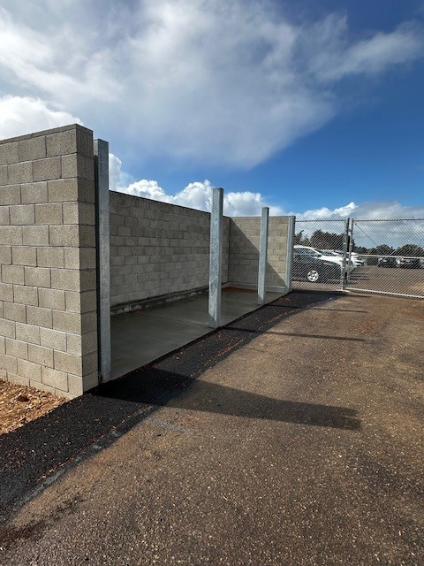
Bundle C Construction Maryland Ave
6
Measure V CBOC Update March 19, 2025

Slide 7
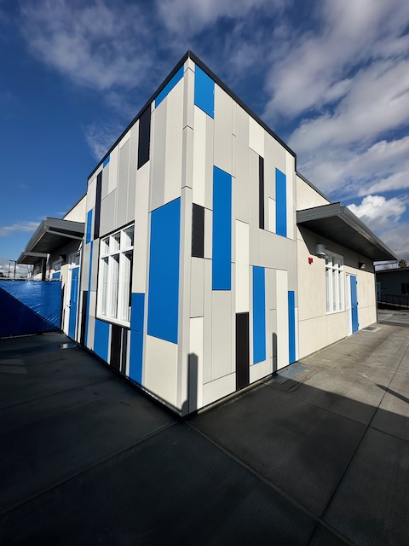
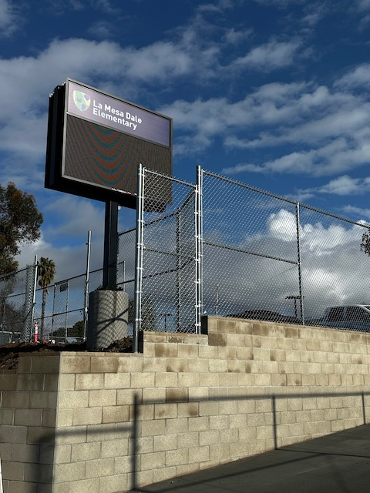
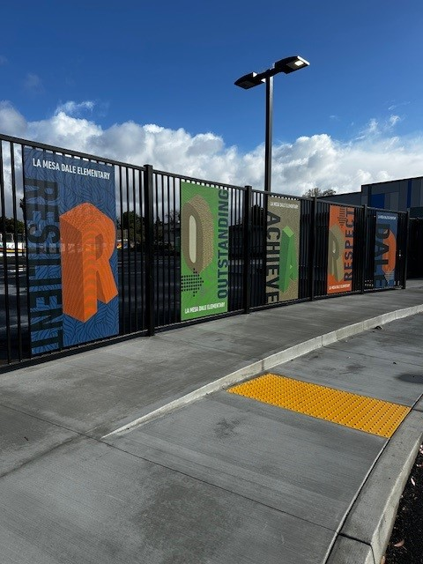
Bundle C Construction La Mesa Dale
7
Measure V CBOC Update March 19, 2025

Slide 8
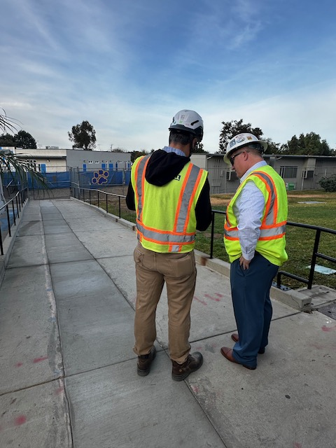
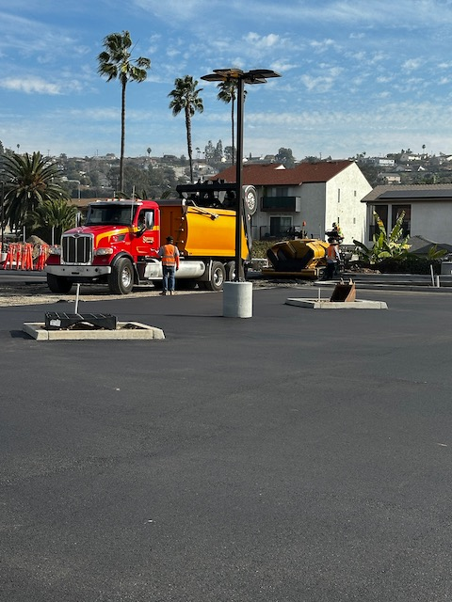
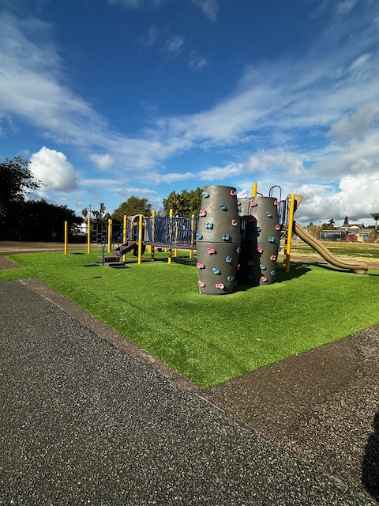
Bundle C Construction La Mesa Dale
8
Measure V CBOC Update March 19, 2025

Slide 9
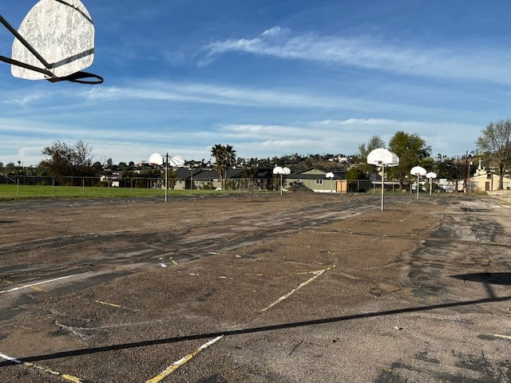
Bundle D Construction
9
Projects
  Avondale Complete
  Rancho Complete
  Bancroft Complete
  Kempton Complete
  La Presa Complete
  STEAM Complete
    STEAM Upper Field Start May 2025
STEAM Upper Field
Measure V CBOC Update March 19, 2025

Slide 10
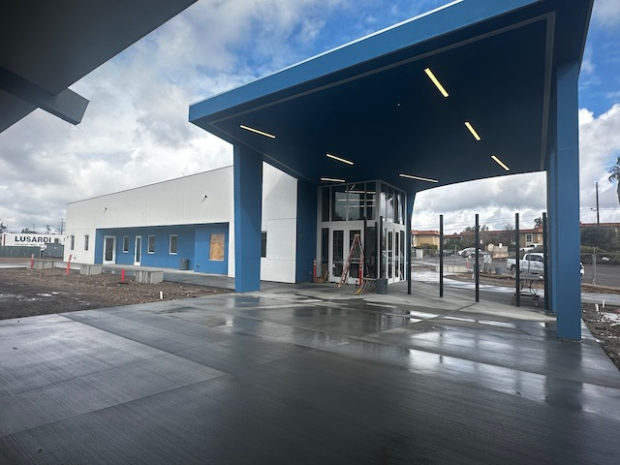
Bundle E Construction
10
  Parkway Portables Complete
  Fletcher Hills Complete
  Northmont Complete
  Murray Manor Complete
  Parkway Site Construction 68% Complete
Parkway Secure Entrance
Measure V CBOC Update March 19, 2025

Slide 11
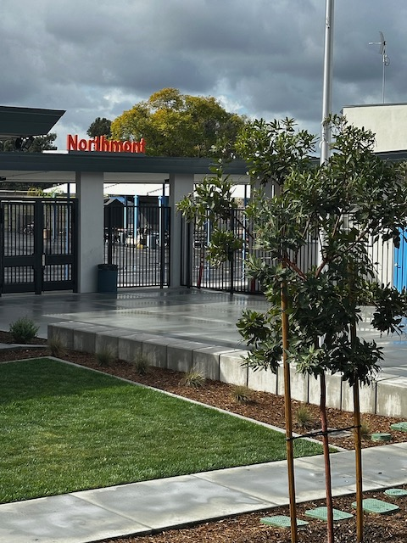
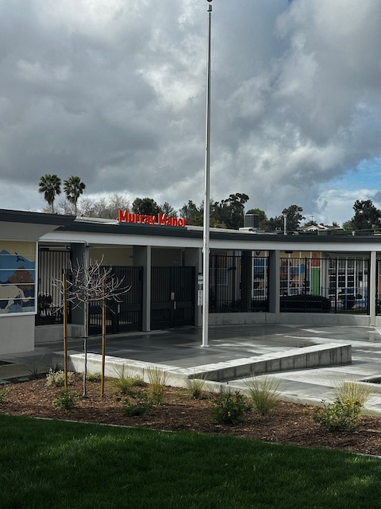
Bundle E Construction Northmont and Murray Manor
11
Measure V CBOC Update March 19, 2025

Slide 12
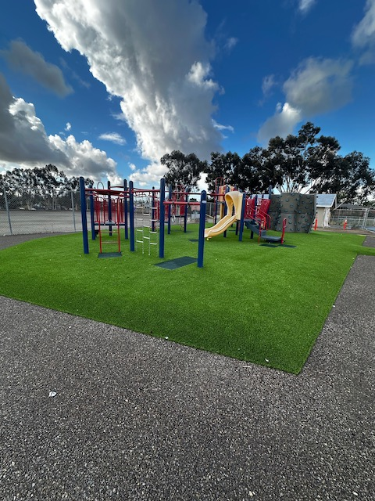
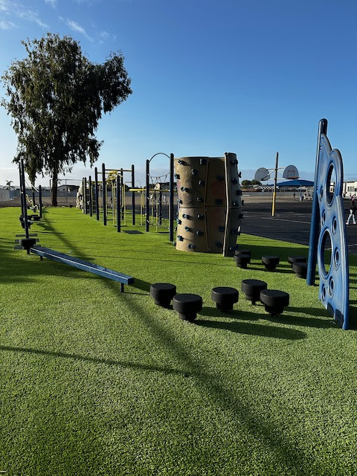
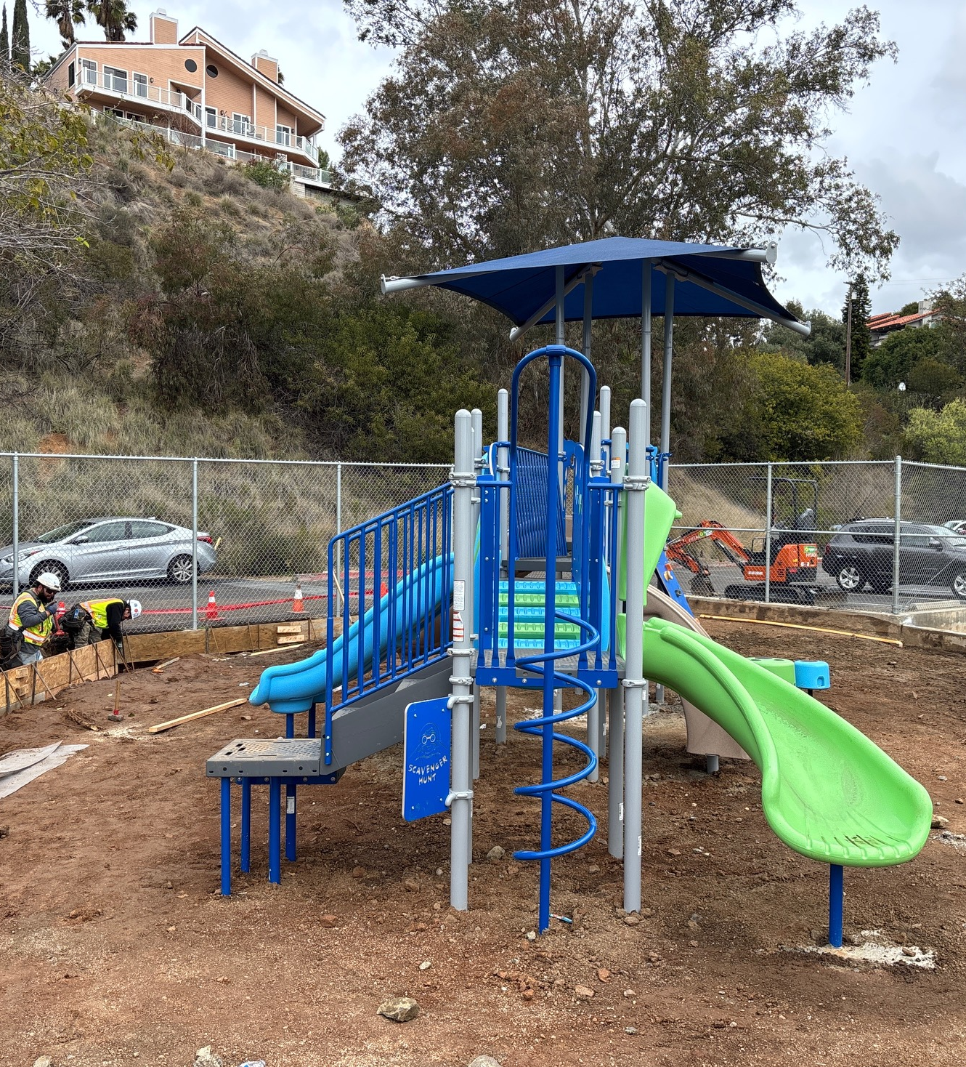
Play Structure/Shade Safety Improvements
12
Rolando
La Presa
Murdock
Measure V CBOC Update March 19, 2025

Slide 13
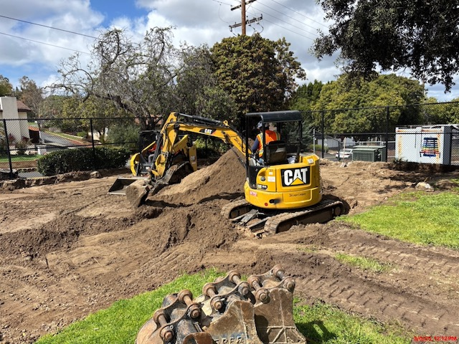
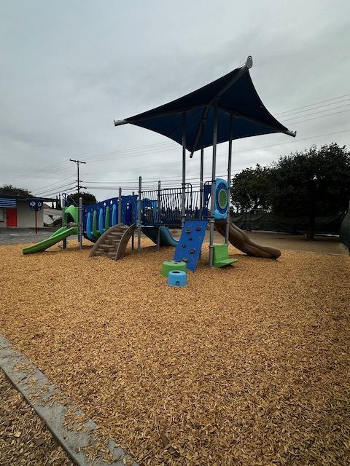
New Playground Structures
13
Five Sites Complete
  Rancho Elementary
  Loma Elementary
  Maryland Avenue Elementary
  Northmont Elementary
  Rolando Elementary
Five Sites in Construction
  Murdock Elementary
  Highlands Elementary
  Lemon Elementary
  Casa De Oro
  Sweetwater Springs
Highlands
Maryland Avenue
Measure V CBOC Update March 19, 2025

Slide 14
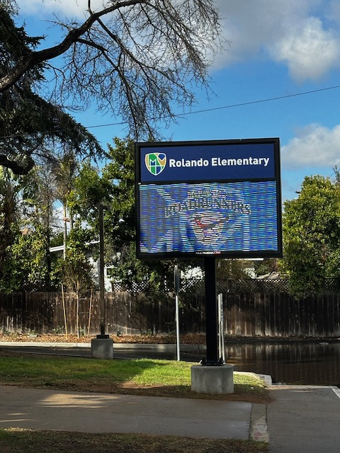
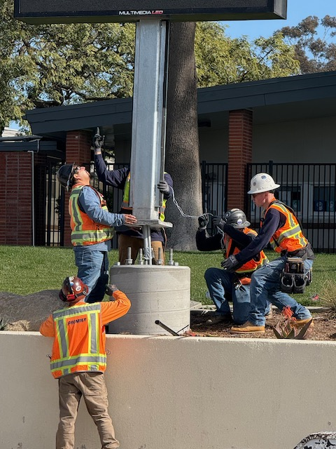
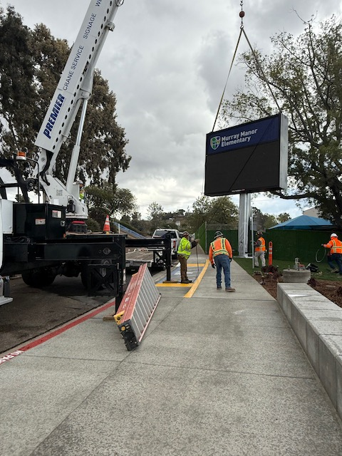
Marquee Construction Complete 20 Sites
14
Rolando
Fletcher Hills
Murray Manor
Measure V CBOC Update March 19, 2025

Slide 15
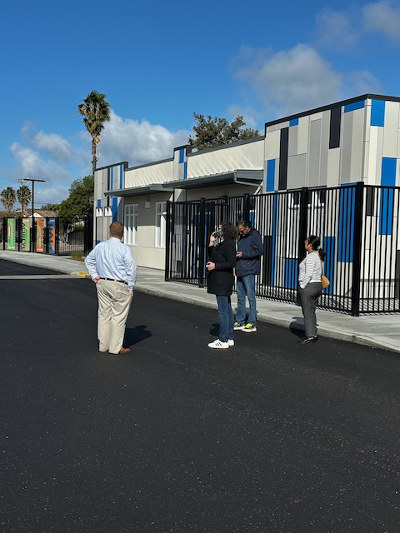
Upcoming Activities
15
  Bundle C
    Complete La Mesa Dale Construction
    Complete Lemon Ave and Maryland Ave Construction
  Bundle E
    Continue Construction Parkway
  Complete Playground/Shade Safety Improvements
  Continue Education Center Planning
Traffic Planning Engineers La Mesa Dale
Measure V CBOC Update March 19, 2025

Slide 16
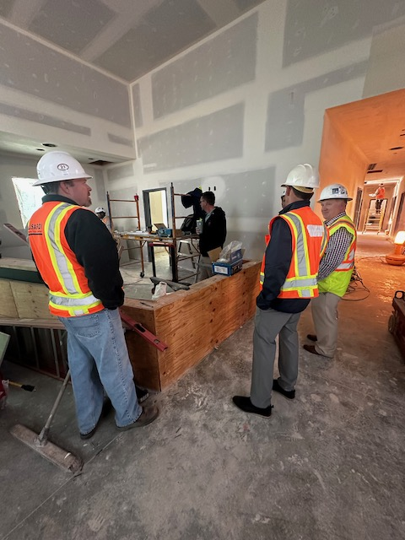
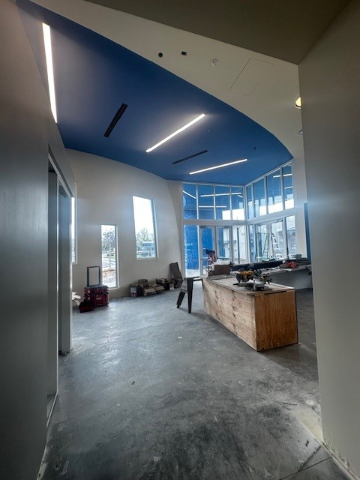
Program Finanacials
Program Revenue Summary
16
Fund 21 Revenue
General Obligation Bonds
August 2021 | Actual | 48,000,000 | General Obligation Bonds, Series A
September 2023 | Actual | 50,000,000 | General Obligation Bonds, Series B
August 2024 | Actual | 38,000,000 | General Obligation Bonds, Series C
Total |  | 136,000,000 | *Cost of Issuance is expensed in Common Costs
Earned Interest
June 2022 | Actual | 235,372.61 | FY 21/22 Earned Interest
October 2022 | Actual | 75,865.64 | Q1 FY 22/23 Earned Interest
December 2022 | Actual | 59,068.40 | Q1 FY 22/23 Earned Interest
February 2023 | Actual | 53,810.48 | Q2 FY 22/23 Earned Interest
April 2022 | Actual | 141,251.95 | Q2 FY 22/23 Earned Interest
April 2023 | Actual | 38,167.08 | Q3 FY 22/23 Earned Interest
June 2023 | Actual | 210,987.68 | Q3 FY 22/23 Earned Interest
June 2023 | Actual | 88,508.95 | Q4 FY 22/23 Earned Interest
June 2023 | Actual | 146,003.72 | Q4 FY 22/23 Earned Interest
June 2023 | Actual | 15,438.62 | Q4 FY 22/23 Earned Interest
October 2023 | Actual | 33,461.56 | Q1 FY 23/24 Earned Interest
December 2023 | Actual | 272,137.92 | Q1 FY 23/24 Earned Interest
January 2024 | Actual | 97,618.00 | Q1 FY 23/24 Earned Interest
January 2024 | Actual | 68,518.54 | Q2 FY 23/24 Earned Interest
March 2024 | Actual | 406,688.35 | Q2 FY 23/24 Earned Interest
April 2024 | Actual | 193,829.42 | Q2 FY 23/24 Earned Interest
April 2024 | Actual | 24,692.45 | Q3 FY 23/24 Earned Interest
June 2024 | Actual | 447,359.23 | Q3 FY 23/24 Earned Interest
July 2024 | Actual | 163,074.83 | Q3 FY 23/24 Earned Interest
July 2024 | Actual | 209,257.56 | Q4 FY 23/24 Earned Interest
October 2024 | Actual | 365,557.87 | Q4 FY 23/24 Earned Interest
October 2024 | Actual | 112,929.95 | Q1 FY 24/25 Earned Interest
Interest Since last adoption |  | 1,298,179
Total Interest To Date |  | 3,459,601
Current Revenue |  | 139,459,601
Measure V CBOC Update March 19, 2025
Notes:
actionButton
No alt text provided
actionButton
No alt text provided
actionButton
No alt text provided
lineStackedColumnComboChart
No alt text provided
Cashflow
No alt text provided
Cashflow
No alt text provided
actionButton
No alt text provided
image
No alt text provided
basicShape
No alt text provided
La Mesa - Spring Valley School Facilities Master Plan Dashboard
No alt text provided
image
No alt text provided
basicShape
No alt text provided
basicShape
No alt text provided
basicShape
No alt text provided
basicShape
No alt text provided
basicShape
No alt text provided
basicShape
No alt text provided
actionButton
No alt text provided
actionButton
No alt text provided
Spending Gauge
No alt text provided
Remaining Budget
No alt text provided
Job to Date Costs
No alt text provided
Current Budget
No alt text provided
tableEx
No alt text provided

Slide 17
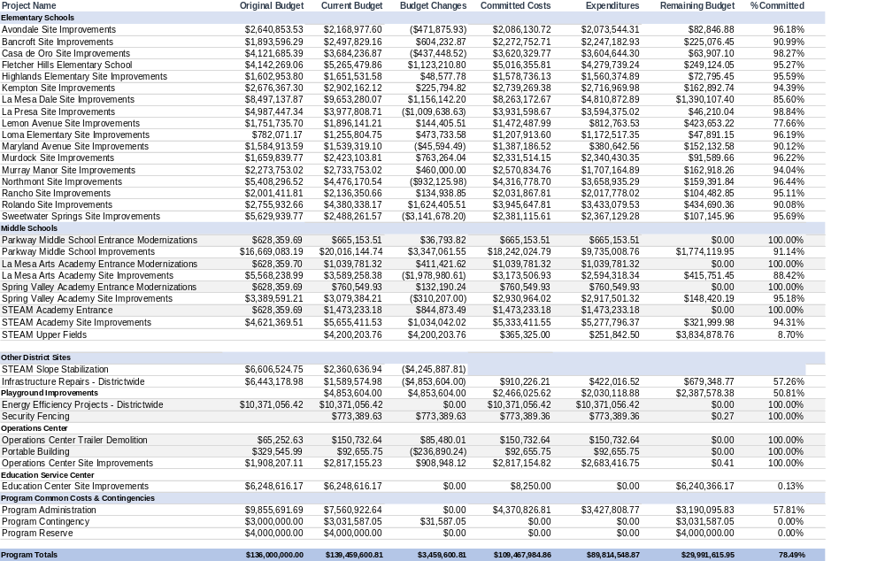
Program Finanacials
Current Program Financial Summary
17
Measure V CBOC Update March 19, 2025
Notes:
actionButton
No alt text provided
actionButton
No alt text provided
actionButton
No alt text provided
lineStackedColumnComboChart
No alt text provided
Cashflow
No alt text provided
Cashflow
No alt text provided
actionButton
No alt text provided
image
No alt text provided
basicShape
No alt text provided
La Mesa - Spring Valley School Facilities Master Plan Dashboard
No alt text provided
image
No alt text provided
basicShape
No alt text provided
basicShape
No alt text provided
basicShape
No alt text provided
basicShape
No alt text provided
basicShape
No alt text provided
basicShape
No alt text provided
actionButton
No alt text provided
actionButton
No alt text provided
Spending Gauge
No alt text provided
Remaining Budget
No alt text provided
Job to Date Costs
No alt text provided
Current Budget
No alt text provided
tableEx
No alt text provided

Slide 18
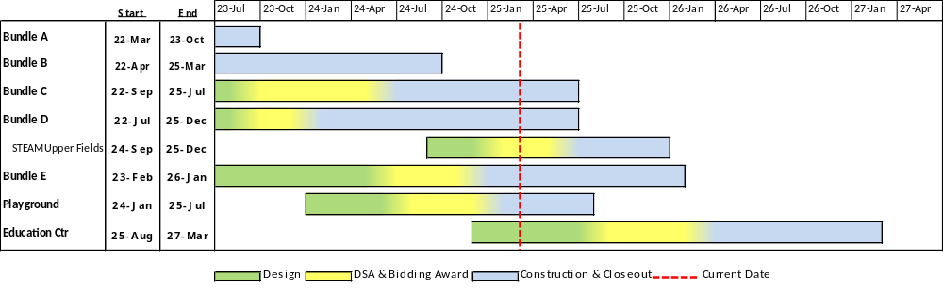
Schedule
18
Measure V CBOC Update March 19, 2025

Slide 19
Local Labor Participation (BBC)
19
Company | City | County | Bundle A | Bundle B & Ops Center | Bundle C | Total
Casper Company | Spring Valley | San Diego County |  | 525,000 | $316,505 | 841,505
Brady Company | La Mesa | San Diego County | 1,070,268 | 787,000 | $449,366 | 2,306,634
ACCO Engineered Systems | San Diego | San Diego County |  | 1,650,000 | $1,057,700 | 2,707,700
Western Rim | Escondido | San Diego County | 750,000 | 2,300,000 | $2,080,700 | 5,130,700
Inline Fence & Rail Company | Lakeside | San Diego County |  | 2,150,000 |  | 2,150,000
FenceCorp | Oceanside | San Diego County |  | 830,000 | $1,595,921 | 2,425,921
Pierre Landscaping | San Diego | San Diego County | 255,000 | 390,000 | $121,370 | 766,370
South Bay Fence | Chula Vista | San Diego County | 60,000 |  |  | 60,000
Kirk Paving | Lakeside | San Diego County |  | 472,000 | $645,298 | 1,117,298
Ace Electric | San Diego | San Diego County |  | 290,000 | $151,260 | 441,260
Precision Electric | Lakeside | San Diego County | 210,000 | 564,000 | $1,416,000 | 2,190,000
Elite Earthworks | Murietta | Out of County | 1,800,000 |  |  | 1,800,000
Marina Landscaping | San Diego | San Diego County |  |  | $536,670 | 536,670
Measure V CBOC Update March 19, 2025

Slide 20
Local Labor Participation (Lusardi)
20
Company | City | County | Bundle D | Bundle E
A Good Roofer, Inc. (Lakeside, CA) | Lakeside | San Diego |  | 204,553
Ace Electric, Inc. (San Diego, CA) | San Diego | San Diego | 651,635 | 1,999,926
Adair Striping, Inc. (Vista, CA) | Vista | San Diego |  | 10,153
Brady West, Inc. (So CA & Central CA) | La Mesa | San Diego | 105,500 | 975,787
Brian Cox Mechanical, Inc. BCM (So Cal (no LA)) | Poway | San Diego | 2,417,016 | 637,927
Buxcon Sheetmetal, Inc. (So Cal) | Santee | San Diego |  | 160,200
Cement Cutting, Inc. (SD, Riverside & Imperial Counties) | San Diego | San Diego | 703,428 | 1,151,683
Centex Glazing, Inc. (La Mesa, CA) | La Mesa | San Diego |  | 307,241
Comprehensive Glass Works (Santee, CA) | Santee | San Diego |  | 15,768
Construction Cleaning Services, Inc. (Bonita, CA) | Bonita | San Diego |  | 33,077
D and D Concrete Construction, Inc. (Poway, CA) | Poway | San Diego |  | 1,367,762
Demcon Concrete Contractors, Inc. (Poway, CA) | Poway | San Diego |  | 281,949
FenceCorp, Inc. (So Cal) | Oceanside | San Diego |  | 1,141,778
Heartland Acoustics and Interiors of California, Inc. (Carlsbad, CA) | Lakeside | San Diego |  | 19,080
HSCC, Inc. | Lakeside | San Diego | 1,711,564
Johnston Tractor, Inc. (SD County) | Alpine | San Diego | 431,840 | 482,989
Kier & Wright Civil Engineers & Surveyors, Inc. (NorCal, SoCaI) | Livermore | Alameda |  | 55,911
Kyne Construction, Inc. (El Cajon, CA) | El Cajon | San Diego |  | 1,697,017
MC Painting aka MC Contracting (Oceanside, CA) | Oceanside | San Diego | 158,765 | 253,762
New Dimension Masonry, Inc. (SD, OC, Rlv., San Bern, Vent., Imp Counties) | San Diego | San Diego | 159,244 | 60,405
Nicholas De Graaf dba Pacific Flagpole Service (San Diego, CA) | San Diego | San Diego | 61,995 | 33,055
OFS Flooring, LP (So Cal) | San Diego | San Diego |  | 185,946
Pacific Coast Cleaning, Inc. (So Cal) | El Cajon | San Diego |  | 8,051
Park West Rescom (So Cal) | Rancho Santa Margarita | Orange |  | 581,557
Pierre Landscape | Irwindale | Los Angeles | 717,608
Premier Sign Service, Inc. (Riverside, CA) | Riverside | Riverside | 318,040 | 148,870
RAP Engineering, Inc. (San Diego ONLY) | San Marcos | San Diego | 195,548 | 386,464
Rocky Coast Builders, Inc. (Escondido, CA) | Escondido | San Diego |  | 600,995
Sherwood Mechanical, Inc. (So Cal) | San Diego | San Diego |  | 402,396
Southwest Construction Services, Inc. (Lakeside, CA) | Lakeside | San Diego |  | 24,988
Spooners Woodworks, Inc. (5o Cal) | Poway | San Diego |  | 81,625
Strelic Plumbing Inc. DBA Advance Plumbing Company | El Cajon | San Diego | 521,240
Sylvester Roofing Company, Inc. | Escondido | San Diego | 17,000
Systems Waterproofing, Inc. (So Cat) | Orange | Orange |  | 51,499
Team West Contracting Corporation | Corona | Riverside | 2,018,975
Vorwaller & Brooks Inc. (Poway) | Poway | San Diego |  | 167,490
West Coast Iron, Inc. WCI (Spring Valley, CA) | Spring Valley | San Diego | 445,744 | 472,968
Western Sign & Awning (San Marcos, CA) | San Marcos | San Diego | 83,910 | 76,569
XYZ Consulting, Inc. (So Cal) | San Diego | San Diego | 121,500 | 56,173
Measure V CBOC Update March 19, 2025

Slide 21
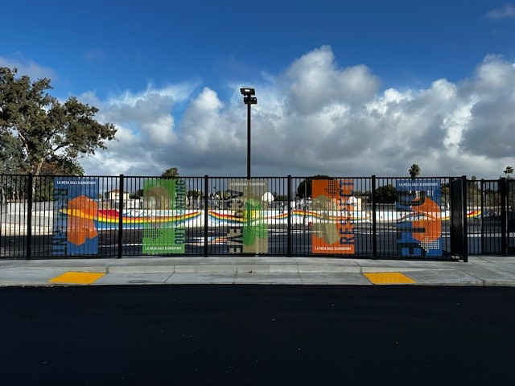
Questions…..

